Slide 1


PresQT
Assessing Researcher and Library Needs for Research Data & Software Preservation Quality Tools
URSSI Worksop
Oct. 23, 2018
Richard Johnson, Natalie Meyers, Sandra Gesing, John Wang
presqt-contact-list@nd.edu
https://presqt.crc.nd.edu/
https://osf.io/d3jx7/
Hesburgh Libraries
Notes:
PresQT Project Team includes our co-PI Sandra Gesing from Notre Dame’s Center for Research Computing who is not with us today at CNI.

Slide 2

PresQT
An implementation grant and previous planning grant funded effort to address needs for preserving data and software. The goal is to collaboratively design, develop, and connect interoperable and repository agnostic Data and Software Preservation Quality Tools.
Implementation grant: https://www.imls.gov/grants/awarded/LG-70-18-0082-18
Planning grant: https://www.imls.gov/grants/awarded/lg-72-16-0122-16
Hesburgh Libraries
Notes:
The CRC and Hesburgh Libraries jointly funded
Part of the research management lifecycle
Not a standalone tool
Interoperable and platform agnostic
PresQT bridges gaps between existing digital library infrastructure, repositories and software reuse.

Slide 3
Motivation
Researchers often respond reluctantly and retroactively to funder and publisher mandates for data and software sharing.
Depositing data can be quite labor intensive.
Metadata enhancement, provenance reconstruction, reformatting and data documentation efforts can present significant barriers to timely and complete data sharing.
Curators engaged near the end of the research life cycle often receive incomplete metadata, at-risk formats, and a paucity of data documentation.
Reuse and reproducibility are jeopardized.
➔ PresQT bridges gaps between existing digital library infrastructure, repositories and software reuse.
Hesburgh Libraries

Slide 4
Target Lifecycle of Research Projects
New project
Selection/
development of tools
Assure quality
of data
Funding ends
Data assembling/
creating
Assure quality
of data
EASY STEP!!!
(ideally)
Preservation of
Data
Reports
Hesburgh Libraries
Notes:
PresQT bridges gaps between existing digital library infrastructure, repositories and software reuse.
Train librarians
Creation of the Repository
Data Management Consulting Team
At Notre Dame, even OSF instance
Fact: researchers who adopted other toolsets - how we support them?

Slide 5
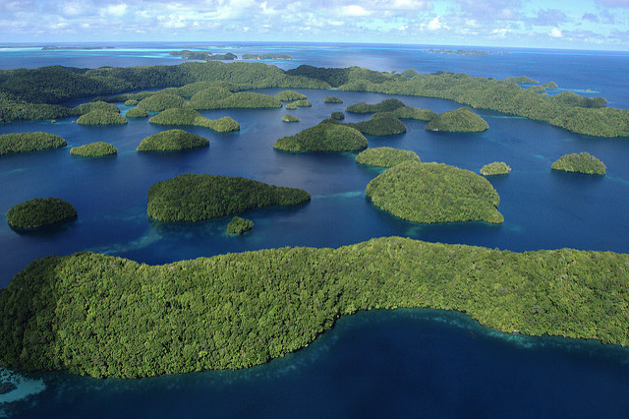


Research Data Management Archipelago
LuxTonnerre
Hesburgh Libraries
Notes:
Different Cultures, processes, technology/tools, etc - Switch cost is high for researchers; Data flow/transactions very difficult
User-centered design?

Slide 6
PresQT Stakeholder Engagement
Identifying Data and Software Preservation Tool Gaps
LuxTonnerre
Hesburgh Libraries
Notes:
PresQT then aspires to connect these various communities of practice and groups together that each are their own type of area they excel in

Slide 7
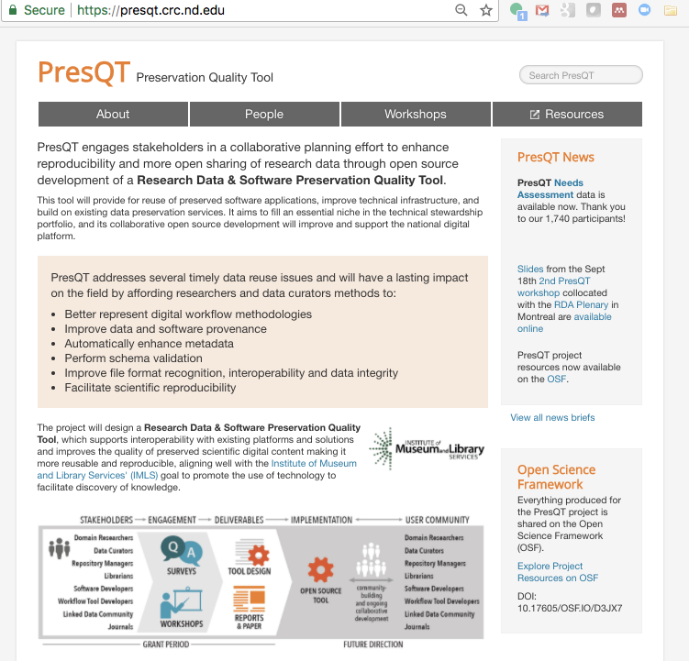
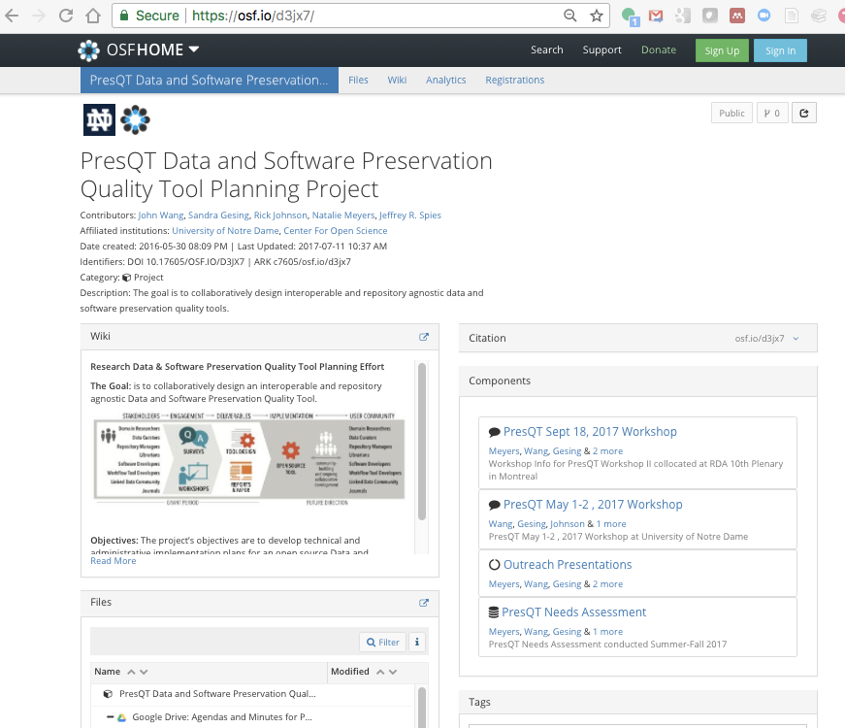
http://presqt.crc.nd.edu/
https://osf.io/d3jx7/
All Resources
available online
Hesburgh Libraries
Notes:
PresQT was conceived as a “radically open grant funded project”. We pledged to share all workshop stakeholder input, workshop materials, meeting minutes and needs assessment online during the active project - not hoarde it til the end. We created an Open Science Framework project for sharing results and gave it a DOI that we submitted with our proposal so reviewers and the funder would know where we would share the info gathered with the funding. The needs assessment questionnaire, response data, and workshop materials we’re talking about today are all available on osf.

Slide 8
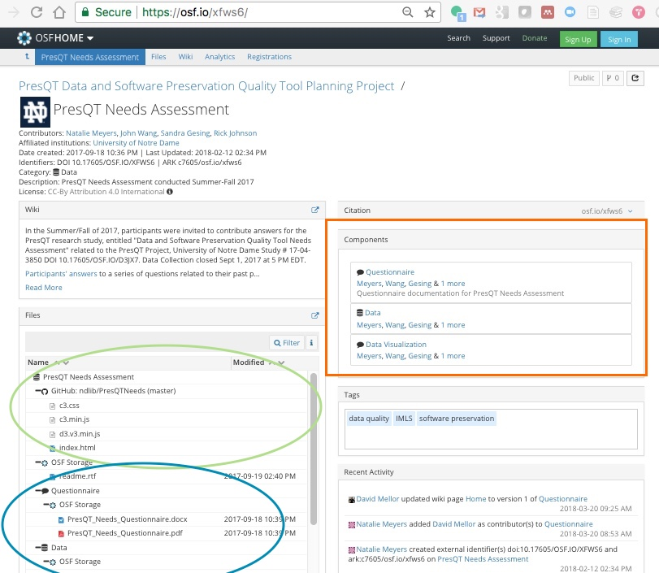
Needs Assessment Data & More
Notes:
Our planning grant produced a lot of data informing our implementation proposal and planned efforts.
Other contributors include: Don Brower in Hesburgh Libraries, for help visualizing & sharing survey results, and Brandon Greenawalt in Notre Dame’s Center for Social Research for administering the survey.

Slide 9
Related Surveys & Case Studies
•Several documented in: Additional Surveys of Interest to the MPS Community
• Wiley Researcher Data Insights (2014) Open Science Researcher (2016)
•Science Gateways Today and Tomorrow (2015)
•American Physical Society Open Data (March 2016)
See: Final Report: Workshops to Gauge the Impact of Requirements for Public Access to Data Produced by NSF-funded Research in Mathematics and the Physical Sciences
•The State of Open Data Report (2016, 2017)
– Springer Nature in association with Figshare and Digital Science
• Open Data The Researcher Perspective (April 2017)
–Elsevier and the Centre for Science and Technology Studies (CWTS)
• Realities of Research Data Management (2017, 2018)
–OCLC Research Four Part Series
Hesburgh Libraries
Notes:
Compared with several past surveys

Slide 10
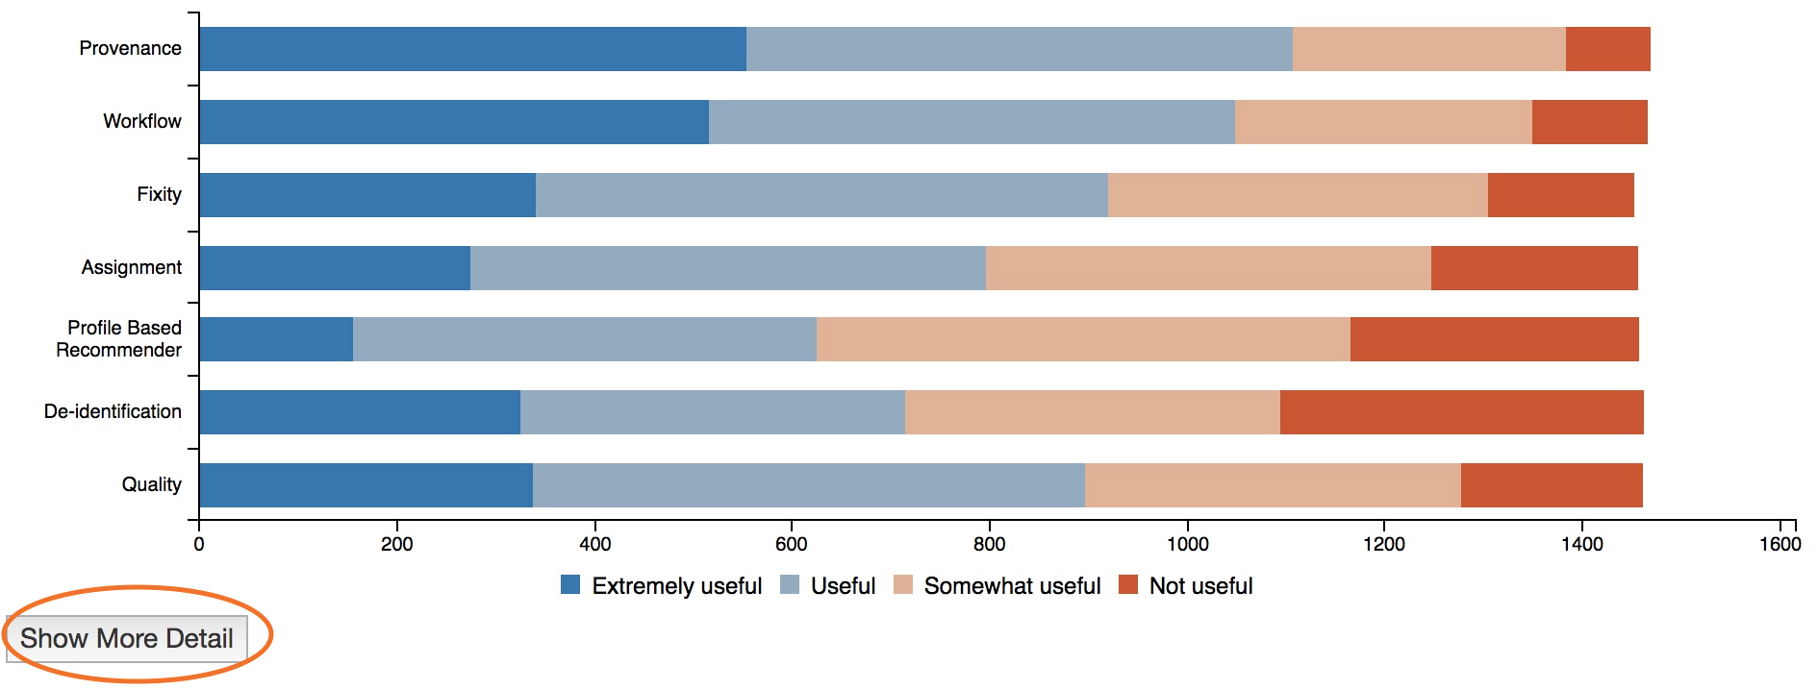
Needs Assessment Results
https://ndlib.github.io/PresQTNeeds/
Indicate whether implementation or integration of tools like those below would ease your path to publishing, sharing, curating, or reusing data or software

Slide 11
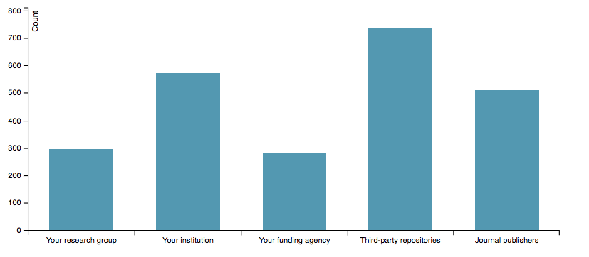
In your estimation, which of the following currently have the infrastructure required to provide long-term public access to your research data? (res_pub_infrastruct)
\
To compare to CNI perspectives on IR landscape see:
Rethinking Institutional Repository Strategies Report of CNI executive Roundtable (May 2017)
Institutional Repository Strategies: What We Learned at the Executive Roundtables (March '17)
https://ndlib.github.io/PresQTNeeds/
Notes:
Based on data, showing that trust still highest in community and institutional repositories

Slide 12
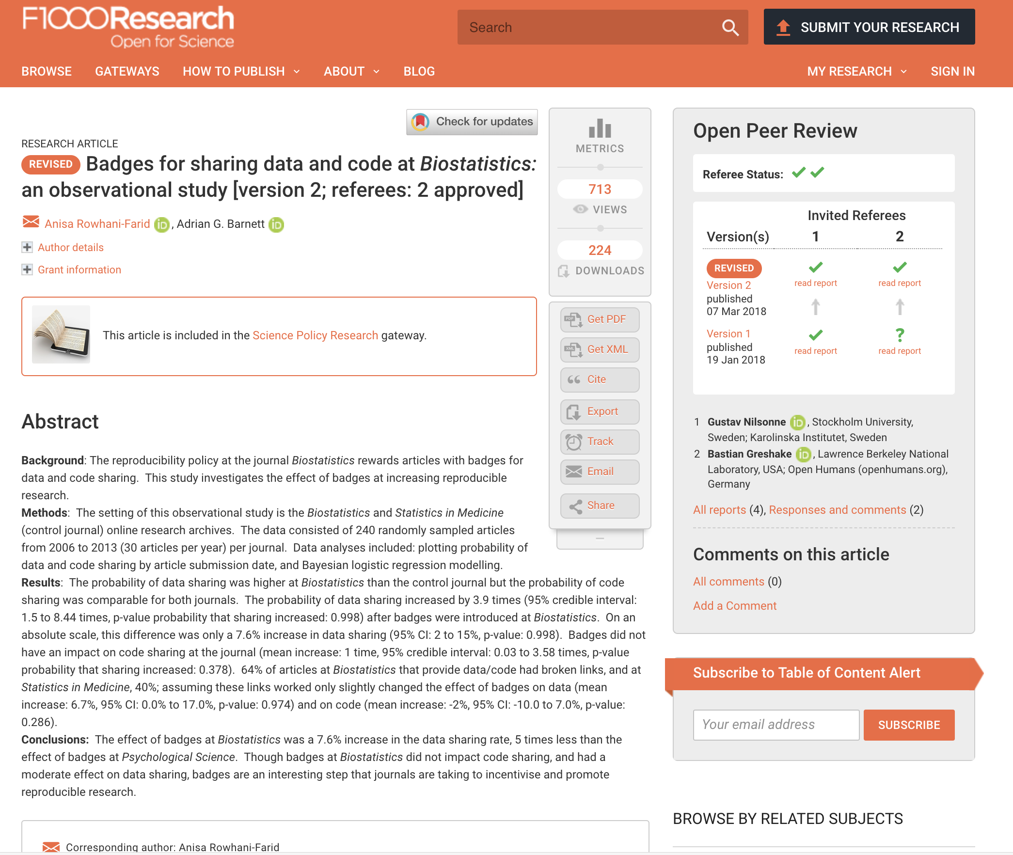
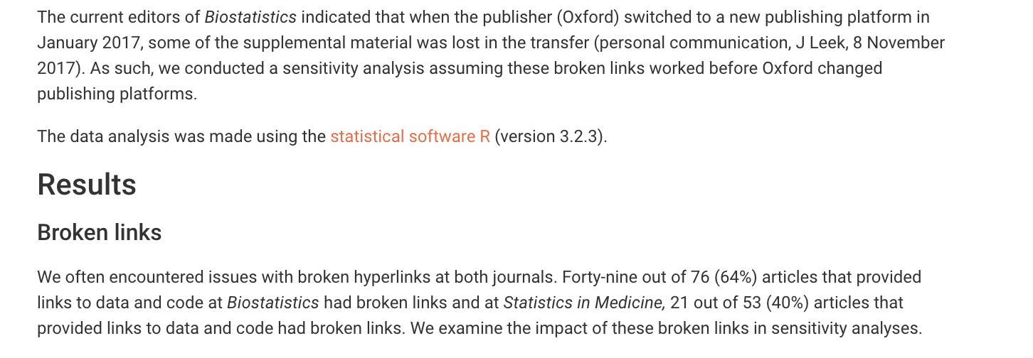
Where’d my Data go?
Notes:
A recent article may in part explain researchers reticence to trust publisher repositories. In Rowhani-Farid A and Barnett AG. Badges for sharing data and code at Biostatistics: an observational study . F1000Research 2018, 7:90 (doi: 10.12688/f1000research.13477.2)
Forty-nine out of 76 (64%) articles that provided links to data and code at Biostatistics had broken links and at Statistics in Medicine, 21 out of 53 (40%) articles that provided links to data and code had broken links.
The current editors of Biostatistics indicated that when the publisher (Oxford) switched to a new publishing platform in January 2017, some of the supplemental material was lost in the transfer (personal communication, J Leek, 8 November 2017).

Slide 13
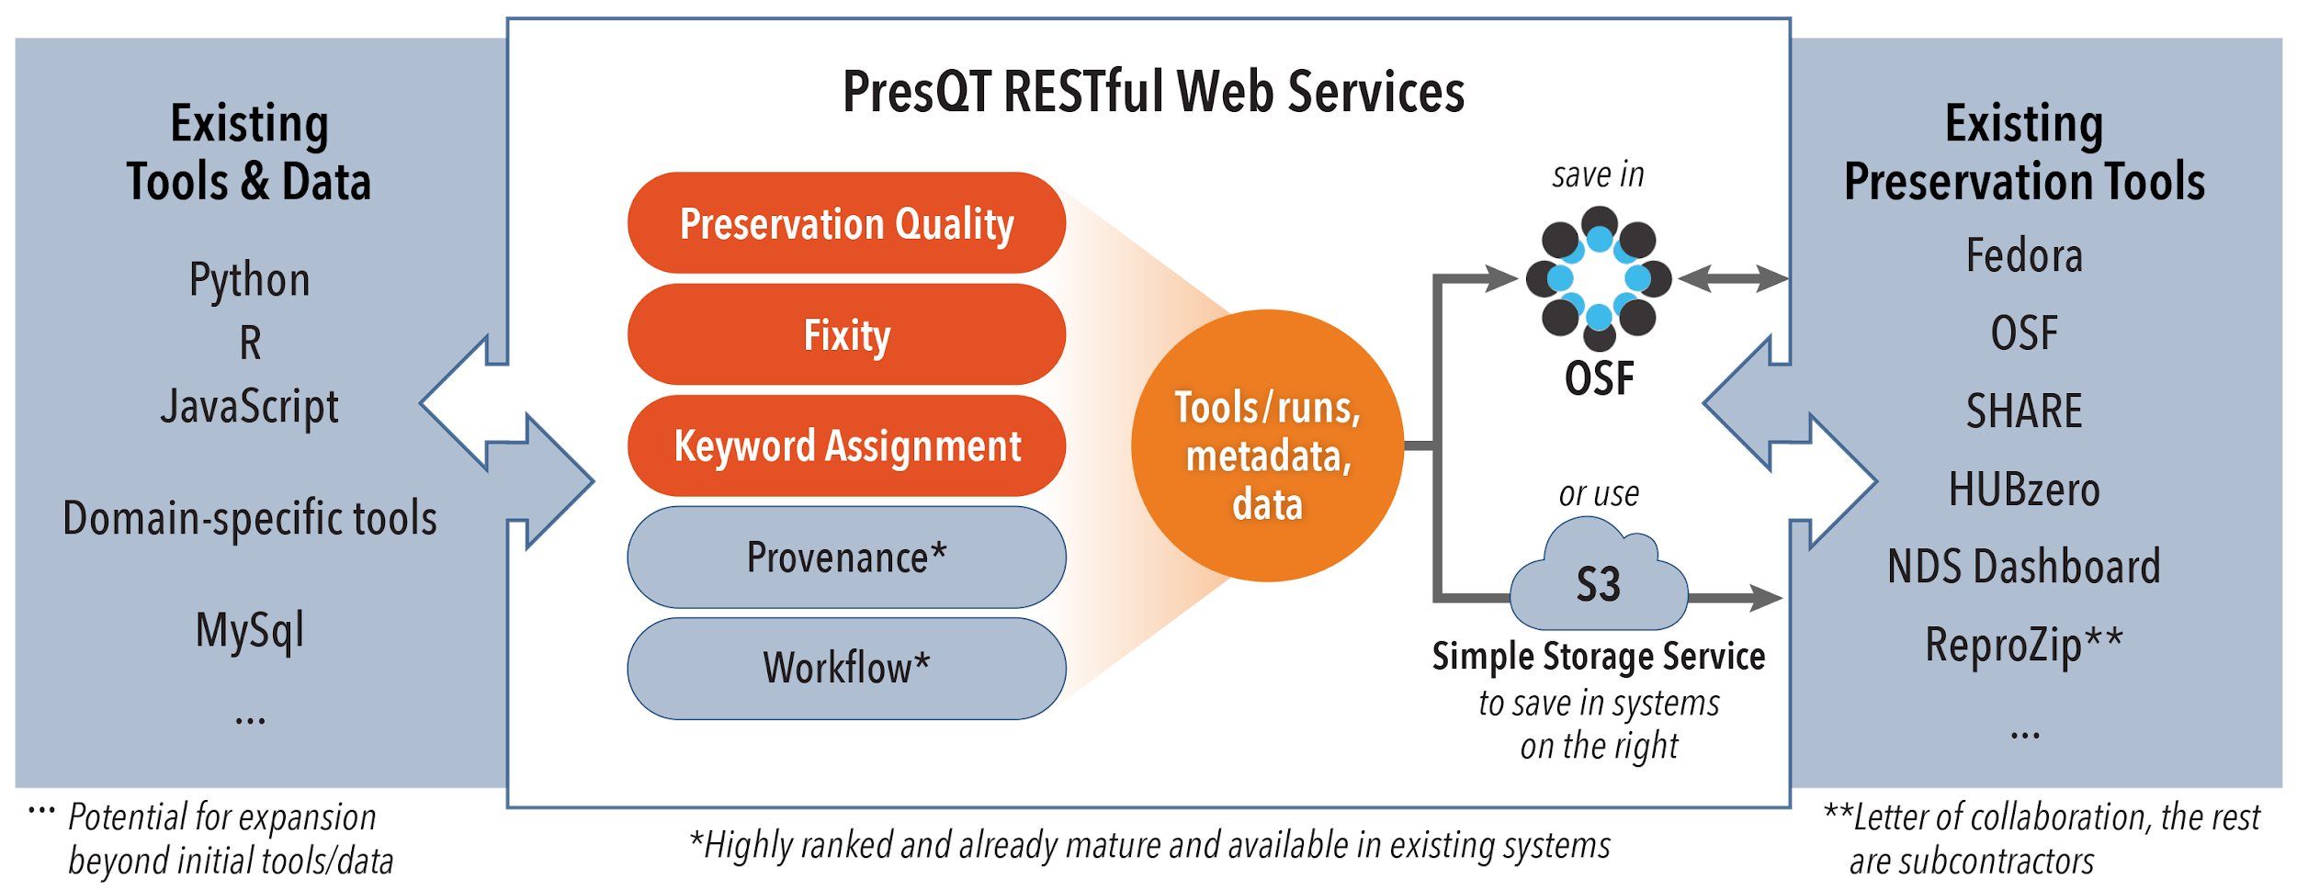
Repository and Tool Agnostic Solutions
Open design of tools and services using standards
Integrate with workflows, tools, and virtual environments
Priority Focus Areas
➔ Available for anyone to adopt what they need and build upon it!
Notes:
Driving towards priority of pushing to community and institutional repositories, with priority areas of generating provenance, capturing workflow, fixity
Connected via REST API Based Webservices in middle. Create new services in red, connect to existing in grey

Slide 14
Open Design Goals
The PresQT services will not be standalone solutions but extend the preservation tool landscape in a way that stakeholders like researchers and librarians can keep working in their chosen computational environment and receive additional features instead of having to switch to a different software. PresQT services form the connection between tools, workflows and databases to existing repositories.
Additional preservation features in tools, workflows and repositories should be easily integrable via standard APIs.
To assure a wide uptake in the community and to lower the barrier for using the novel features, we will assure a user-centered design and collaborative development.
Hesburgh Libraries
Notes:
Part of the research management lifecycle
Not a standalone tool
Interoperable and platform agnostic
PresQT bridges gaps between existing digital library infrastructure, repositories and software reuse.

Slide 15
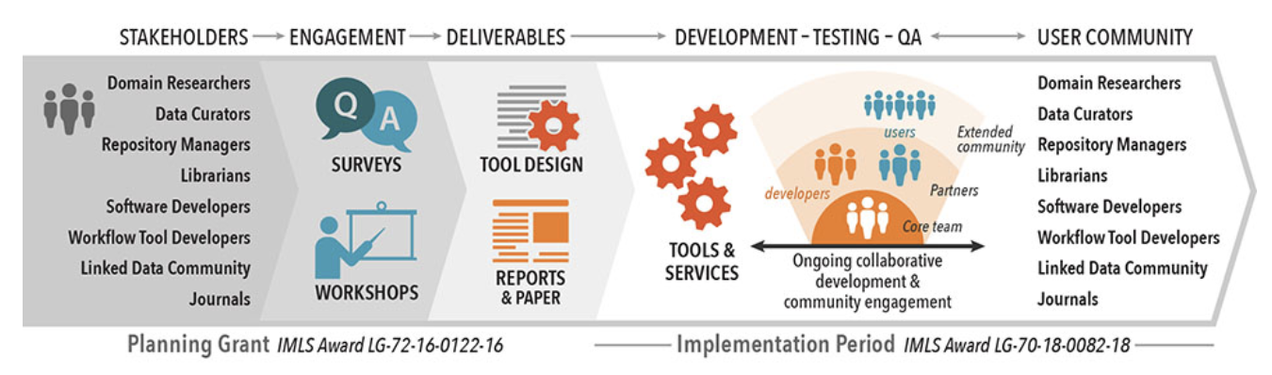
Collaborative Effort
Where we are now – Toward end of planning grant, the two workshops are concluded, Survey Results Shared, Implementation grant has started, Kick-off meeting at ND conducted.
Hesburgh Libraries
Notes:
All the planning phase resources gathered during stakeholder engagement are available to inform stakeholders’ future projects. Tool designs and final report will be actionable by anyone who wants to inform their planning through the priorities identified in PresQT.
We have also submitted an implementation proposal, and if that’s funded we’ll be move forward from the planning phase to further collaboratively web services & tools to fill the prioritiy identified needs.

Slide 16
Partners and Committed Collaborations
Funded sub-awardees
Sheridan Libraries, Johns Hopkins University
NDS
UC San Diego Library
HUBzero team, Purdue University
Yale University Library (EaaSI)
Collaborators and Testing Partners
Libraries at Amherst College, Fontbonne University, Tuskegee University, Confederation of Open Access Repositories (COAR)
ReproZip, Jupyter, CERN, RDA groups
Midwest Big Data Hub, Science Gateways Community Institute, URSSI, Center for Open Science, Data Curation Network, Software Preservation Network

Slide 17
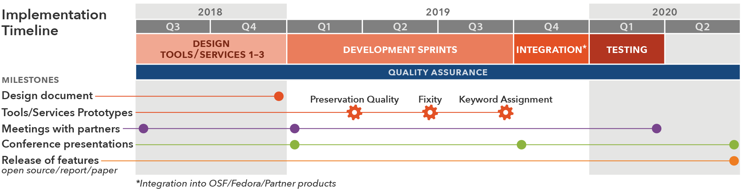
Implementation Grant Timeline
IMLS NLG-Libraries-FY18-1: https://www.imls.gov/grants/awarded/LG-70-18-0082-18
Hesburgh Libraries
Notes:
Looking at the implementation grant timeline

Slide 18

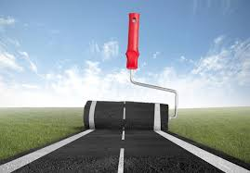
Technical Management Plan – Design
Definition of requirements during kick-off meeting and video calls
Definition & technical requirements from partner systems stakeholders
Preservation quality: what does it exactly include?
Fixity: how to secure correct information?
Keyword assignment: machine-learning for previously chosen keywords?
➔
Notes:
We had a deeper dive into requirements during our kick-off with sub contract awardees in Sept.

Slide 19
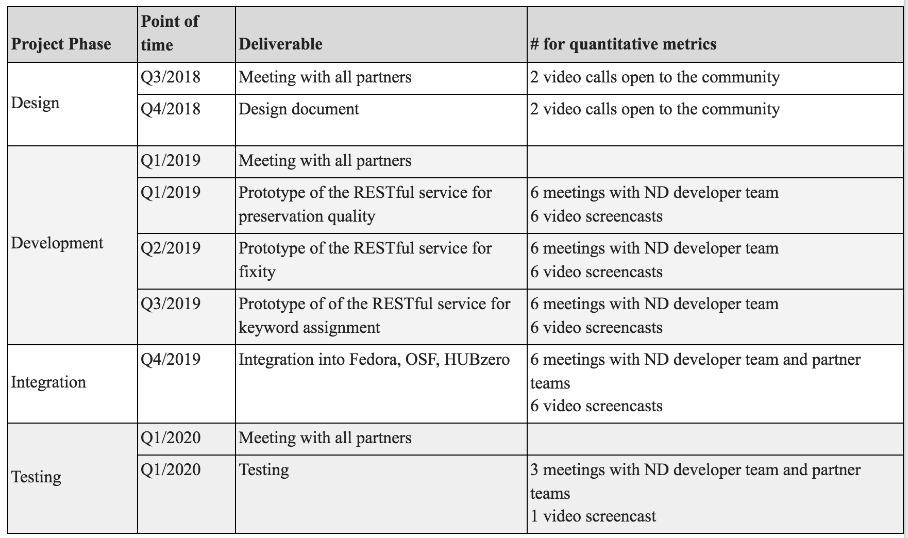
Open Design - Timeline

Slide 20
Open Design - Timeline
Testing with Partners

Slide 21
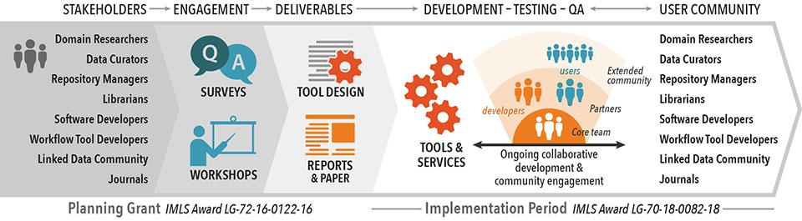
Thank you!
PresQT on the web: https://presqt.crc.nd.edu/
Subscribe to our newsletter!
These slides are available at:
https://osf.io/d9hbr/
Hesburgh Libraries
Notes:
Once again, we’d like to acknowledge our colleagues Don Brower in Hesburgh Libraries for help visualizing survey data, and Brandon Greenawalt in Notre Dame’s Center for Social Research for administering the survey.

